Slide 1
PIP2001 CAPSTONE PROJECT FINAL REVIEW
Effectively writing YARA rules to detect malwares.
Batch Number: 2021-2025
Under the Supervision of,
Ms. Riya Sanjesh
Assistant Professor
School of Computer Science Engineering & Information Science
Presidency University
Roll Number | Student Name
20211CSG0032 | MEENAKUMARI B M
20211CSG0014 | HARSHITHA M
20211CSG0019 | SUHAAS R
20221LCG0006 | SUPRITHA G M

Slide 2
Introduction
YARA, an acronym for "Yet Another Recursive Acronym," has become an essential tool in malware detection and analysis due to its ability to classify and identify files based on defined patterns. Developing efficient YARA rules is a challenging endeavor that demands substantial expertise and meticulous attention to detail. Challenges include the need for accurate signatures to minimize false positives and negatives, creating generic rules that cover multiple malware samples, and optimizing scanning performance on large datasets. This project addresses these challenges by proposing a comprehensive framework to automate, refine, and enhance the YARA rule-writing process. A key focus of this study is creating a search engine to streamline the selection of YARA signature patterns.

Slide 3
Literature Review
PAPER TITLE | YEAR | AUTHOR | ADVANTAGES | DISADVANTAGES
Malware Detection Using Automated Generation of YARA Rules on Dynamic Features | 2020 | Qiao et al | Automates YARA rule creation, improving detection without manual input. | Relies on quality data and may miss stealthy malware.
Automatic Yara Rule Generation Using Biclustering | 2020 | Edward Raff, Richard Zak, Gary Lopez Munoz, William Fleming, Hyrum S. Anderson, Bobby Filar | AutoYara automates YARA rule creation, saving significant time for analysts. | It struggles with complex malware using obfuscation techniques​
Assessing the Effectiveness of YARA Rules for Signature-Based Malware Detection and Classification | 2021 | Adam Lockett | YARA is flexible and detects obfuscated malware. | It struggles with polymorphic malware and needs frequent updates.
Embedded YARA Rules: Strengthening YARA Rules Utilizing Fuzzy Hashing and Fuzzy Rules for Malware Analysis | 2022 | Nitin Naik, Paul Jenkins, Nick Savage, Kshirasagar Naik, Longzhi Yang | YARA rules are flexible, effectively detecting obfuscated malware | They struggle with polymorphic malware that alters its code to evade detection
Enhanced YARA Rule Framework for Polymorphic Malware Detection | 2023 | S. K. Gupta, R. K. Jain | Improves detection of polymorphic malware using adaptive YARA rules. | Requires extensive training data for effective performance.

Slide 4
Research Gaps Identified
The review of existing literature on YARA rule generation and optimization reveals significant progress in enhancing malware detection capabilities. However, several challenges persist in the current methodologies that limit their applicability and effectiveness. These gaps present opportunities for further research to refine and improve the process of creating, optimizing, and applying YARA rules for malware detection. Below are the detailed research gaps identified areas :
1.Limited Detection of Polymorphic Malware
2.Dependence on High-Quality Datasets
3.Challenges in Detecting Obfuscated Malware
4.High Computational Overhead in Scanning Large Datasets
5.Lack of Generic Rules for Malware Families
6.Frequent Rule Updates Required
7.Insufficient Automation in Rule Generation
8.Scalability Issues in Large-Scale Malware Analysis

Slide 5
Proposed Methodology
Pattern Search Engine: Create a search engine to quickly identify and rank effective YARA signature patterns.
Automated Rule Generation: Automatically generate YARA rules that cover a specific set of malware files.
Optimized Scanning: Implement methods to minimize scanning time on large datasets, speeding up signature selection.
Generic Signatures: Design rules that can detect multiple malware samples using a single, broad signature.

Slide 6
Objectives
Develop Efficient YARA Rules: To create YARA rules that are both accurate and efficient in identifying known malware signatures.
Adapt to Polymorphic Malware: Implement techniques to handle code obfuscation and polymorphic malware that changes its structure.
Automate Rule Generation: Explore methods for automatic or semi-automatic YARA rule generation to enhance scalability and reduce manual effort.
Ensure Broad Malware Coverage: Create generic YARA rules that can cover multiple variants of malware, improving detection across a wide range of threats.
Minimize Scanning Time: Focus on writing rules that reduce system scanning times while maintaining accuracy.

Slide 7
System Design & Implementation
System Overview:
The system is designed with modularity in mind to ensure flexibility and scalability. The core functionality includes the automatic generation of YARA rules based on malware patterns extracted from both static and dynamic analyses. The system follows a structured workflow that consists of five main stages:
Data Collection
2. Pattern Analysis
3. Rule Generation
4. Performance Optimization
5. Rule Testing and Refinement

Slide 8
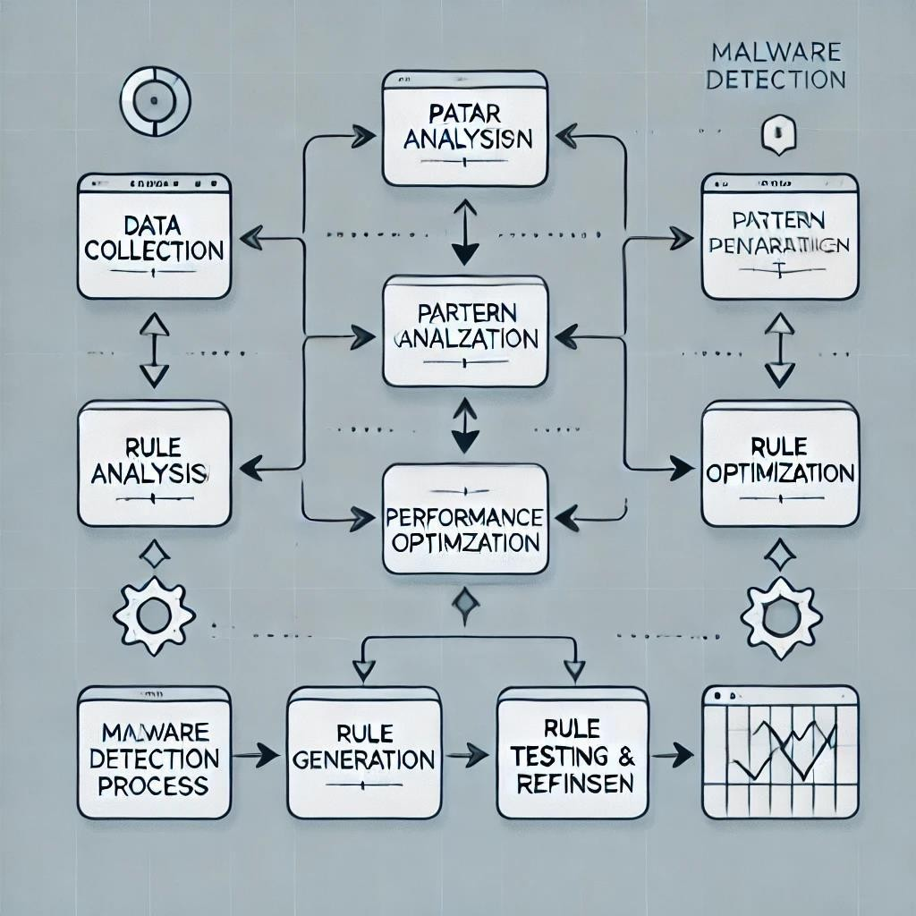
Implemention Details
Programming languages and Frameworks :
PYTHON, YARA, Machine Learning Libraries, Sandbox Tools
Data Structures and Algorithms :
Pattern Matching Algorithms, Data Structures for Optimization
Performance Considerations :
Parallelism, Distributed Computing
Testing and Debugging :
Unit Testing, Integration Testing
User Interface and Deployment :
Dashboard, Rule Management, Deployment Pipeline, Scalability

Slide 9
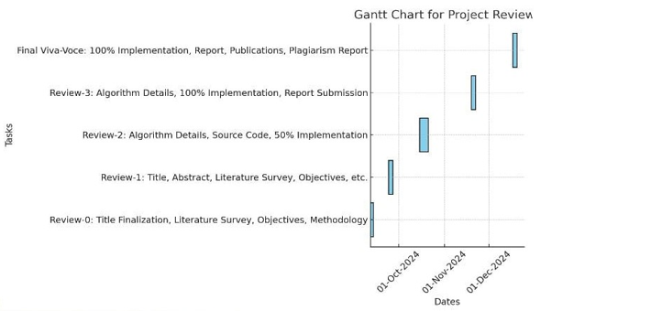
Timeline of Project

Slide 10
Outcomes / Results Obtained
The outcomes of this project focus on achieving the key goals of automating YARA generation, improving malware detection accuracy, optimizing scanning performance, and ensuring scalability for larger datasets. The successful implementation of the proposed system has resulted in several significant benefits:
1.Automated YARA Rule Generation
2.Enhanced Malware Detection Accuracy
3.Optimized Performance and Reduced Scanning
4.Scalability for Larger Datasets
5.Real-Time Malware Detection

Slide 11
Results Obtained
The outcomes of this project demonstrate the effectiveness of automating YARA rule generation for malware detection. The results confirm that the system enhances the efficiency and accuracy of detecting malware, optimizing scanning performance, and providing a scalable solution for large datasets. Below is a detailed discussion of the key results:
1.YARA Rule Generation Performance
2.Detection Accuracy
3.Optimized Performance and Faster Scanning
4.Continuous Rule Refinement
5.Scalability for Large Datasets
6.Real – Time Detection

Slide 12
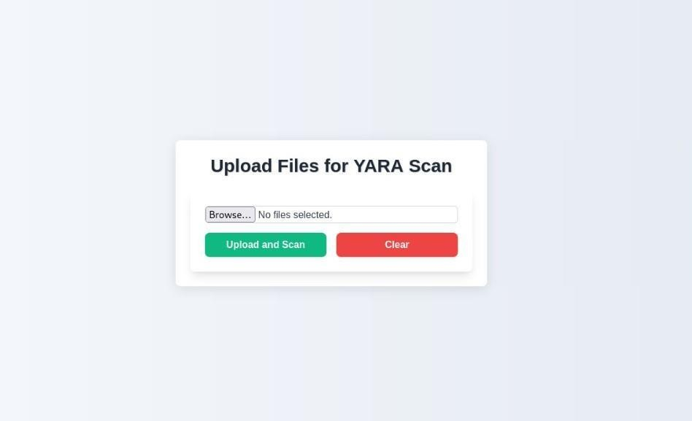
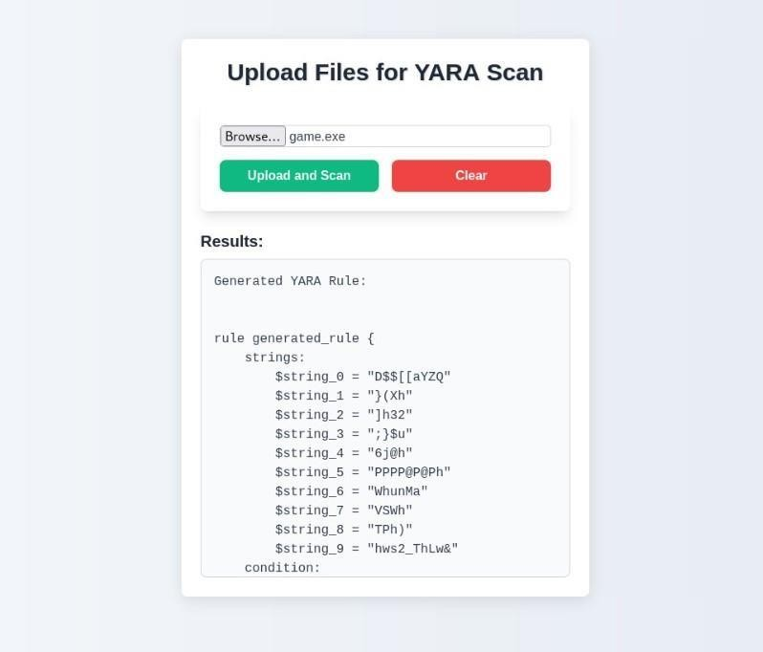

Slide 13
Conclusion
The automated YARA rule generation system reduces the time and effort required for manual rule creation, enabling faster and more consistent detection of a wide range of malware strains. The key conclusions drawn from this work are as follows:
1.Successful Automation of YARA Rule Generation
2.High Accuracy in Malware Detection
3.Performance Optimization for Scanning Large Datasets
4.Scalability and Flexibility
5.Real - Time Malware Detection
6.Continuous Refinement and Adaptability

Slide 14
CONCLUSION
Future Work:
While the system demonstrated promising results, there are several areas for improvement. Future work could focus on enhancing the system’s ability to detect more sophisticated malware techniques, such as polymorphism and fileless malware. Integrating machine learning models for automatic rule refinement and improving the scalability of the system to handle even larger datasets are also important next steps. Additionally, extending the system to support real-time behavioral analysis and cross-platform detection could make it more versatile and capable of adapting to evolving cybersecurity threats. In conclusion, this project highlights the potential of automating malware detection using YARA rules. By combining efficiency, accuracy, and scalability, the system offers a valuable tool for cybersecurity professionals. As cyber threats continue to evolve, the system’s ability to automatically adapt and generate detection rules will be crucial in maintaining an effective defense against new and emerging malware strains.

Slide 15
References
[1] Qiao et al. (2020). Malware Detection Using Automated Generation of YARA Rules on Dynamic Features. [Link to paper]
[2] Edward Raff, Richard Zak, Gary Lopez Munoz, William Fleming. (2020). Automatic Yara Rule Generation Using Biclustering. Journal of Cryptography and security. [Link to paper]
[3] Adam Lockett. (2021). Assessing the Effectiveness of YARA Rules for Signature- Based Malware Detection and Classification. [Link to paper]
[4] Nitin Naik, Paul Jenkins, Nick Savage, Kshirasagar Naik. (2022). Embedded YARA Rules: Strengthening YARA Rules Utilizing Fuzzy Hashing and Fuzzy Rules for Malware Analysis. [Link to paper]
[5] YARA Official Documentation: https://yara.readthedocs.io
[6] Yara Malware Detection https://www.veeam.com/blog/yara-rules-malware-detection-analysis.html#%3A~%3Atext%3DCreating%20YARA%20Rules%2C-Defining%20Objectives%26text%3DFirst%2C%20identify%20the%25
[7] YARA Rule Generation https://www.picussecurity.com/resource/glossary/what-is-a-yara-rule
[8] yarGen https://github.com/Neo23x0/yarGen
[9] https://search.app/?link=https%3A%2F%2Finsights.sei.cmu.edu%2Fblog%2Fwriting-effective-yara-signatures-to-identify-malware%2F&utm_campaign=aga&utm_source=agsadl2%2Csh%2Fx%2Fgs%2Fm2%2F4

Slide 16
Github link
https://github.com/Suhaasr27/YARA

Slide 17
Publication Details
TITLE : Effectively writing YARA rules to detect malwares
AUTHORS : Meenakumari B M, Harshitha M, Suhaas R, Supritha G M, Riya Sanjesh
JOURNAL : Internation journel of Innovative Research in Computer and Communication Engineering (IJIRCCE)
VOLUME AND ISSUE : Volume 13, Issue 1, January 2025
SERIAL NUMBER : SJIF Rating=8.448, ISSN=2582-3930,
LINK : https://ijircce.com/admin/main/storage/app/pdf/wsWCLzLcMmQAhVTCityz06euTceC0GBHwMdflmPn.pdf
RECOGNITION : Successfully published and Certificate Awarded

Slide 18

Thank You

